Slide 1
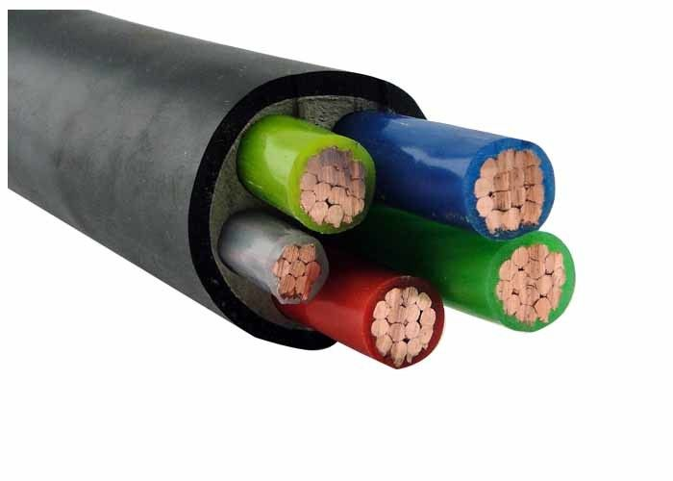
Daily review
CFU 1
Differentiate between a conductor and an insulator, giving one example of each
Conductors
A material that allows the flow of charge.
Insulators
A material that does not allow the flow of charge.
CFU 2
Look at the electrical cable in the picture. Describe the structure of the cable, mentioning reasons for locations of conductors and insualtors

Slide 2
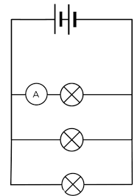
Daily review
CFU 1
Look at the circuit diagram below, is this a series or parallel circuit? Justify your answer.
Series Circuit
Two or more electrical components connected side by side on the same conducting pathway.
A break in any part of the circuit effects all components in the circuit.
Parallel Circuit
Two or more electrical components connected on different conducting pathways on the same circuit.
A break in one conducting pathway will still allow charge to flow through any other pathways.
CFU 2
Where might you find this kind of circuit? Explain why it is suited to this location.

Slide 3
Current, Voltage, and Resistance Year 9 Physics

Slide 4
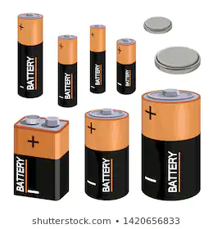
Learning Objectives
CFU
What are we going to learn today?
Define the following terms in relation to electric circuits
Current
Resistance
Voltage
Draw voltmeters and ammeters into circuit diagrams
Activate Prior Knowledge
Batteries come in all different shapes and sized.
How are these batteries different?
Where might you find different ones and why?

Slide 5
Concept Development
CFU 1
Define electrical current.
Electrical Current
The rate of flow of electric charge past a point.
Measured by counting the number of electrons passing a point of a circuit each second.
Unit of measurement
Amperes
Symbol – A
Measured using an ammeter
Must be connected in series in order to measure the current through an area of a circuit.
CFU 2
On your whiteboards write the unit of measurement, and symbol of current.
CFU 3
Look at the picture: Explain how you know the red side has a larger current than the blue side.
Vocabulary
Electric Charge: charged particles, in a circuit this is usually negative electrons.

Slide 6
Concept Development
CFU 1
Explain why do electrons either side of a globe have different levels of potential energy.
Voltage
A globe transforms potential energy into other forms of energy e.g. light.
Electrons have different amounts of energy before, and after the globe.
This difference in potential energy across the globe is called the voltage or potential difference.
A battery (or power pack) restores energy to the electrons as they travel around the circuit.
CFU 2
What role does a battery play in a circuit.
CFU 3
Think-pair-share: When a battery goes flat, why does your torch light not come on?
Vocabulary
Potential difference: difference in electrical potential energy carried by electrons at different points in a circuit.

Slide 7
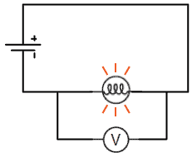
Concept Development
CFU 1
On your whiteboards write the unit of measurement and symbol for Voltage.
Voltage
Measured in volts
Symbol – V
Measured using a voltmeter
Voltmeters are installed in parallel across 2 points of the circuit.
This shows the difference in potential energy from one point, to the next.
CFU 2
Think-pair-share: The voltmeter will tell us the voltage through the globe. What is voltage a measurement of?
Vocabulary
Parallel: Connected across the component on a different conducting pathway.

Slide 8
Concept Development
CFU 1
Describe how resistance effects the current in a circuit.
Resistance
A measurement of how difficult it is for charged particles (electrons) to move through it.
Most wires are made of good conductors and therefore have low resistance.
Measured in ohms
Symbol - Ω
The resistance of a circuit can determine the current.
Resistors are devices that deliberately have high resistance in order to reduce the size of the current in a circuit.
CFU 2
Explain the role of a resistor in a circuit?
CFU 3
On your whiteboards, write the unit of measurement and symbol for resistance.
Vocabulary
Ohms: The unit of measurement of resistance.

Slide 9

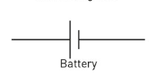
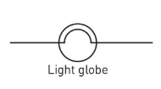
Skill Development
CFU 1
Ammeter or Voltmeter?
Positioning Voltmeters and Ammeters in a circuit
Ammeter – put in series with the component Voltmeter – put in parallel with the component *Note – Ensure that Ammeters are on the same conducting pathway.
CFU 2
Ammeter – in series with the component.
Alter the circuit diagram below to include an ammeter to measure the current through globe A.
CFU 5
Given A and B are both on the same conducting pathway, do you think you would need a second ammeter to measure the current through globe B?
B
A

Slide 10
Skill Development
CFU 1
Ammeter or Voltmeter?
Positioning Voltmeters and Ammeters in a circuit
Ammeter – put in series with the component Voltmeter – put in parallel with the component *Note – Ensure that Ammeters are on the same conducting pathway.
CFU 2
Voltmeter – in parallel with the component.
Alter the circuit diagram below to include a voltmeter to measure the current through globe B.
B
A

Slide 11
Skill Development
CFU 1
Ammeter or Voltmeter?
Positioning Voltmeters and Ammeters in a circuit
Ammeter – put in series with the component Voltmeter – put in parallel with the component *Note – Ensure that Ammeters are on the same conducting pathway.
CFU 2
Voltmeter – in parallel with the component.
Alter the circuit diagram to include an instrument to measure the potential difference across globe A.
CFU 3
Think-pair-share: If globe A and B have the same resistance, do you think they current through them would be the same or different?
A
B

Slide 12
Skill Development
CFU 1
Ammeter or Voltmeter?
Positioning Voltmeters and Ammeters in a circuit
Ammeter – put in series with the component Voltmeter – put in parallel with the component *Note – Ensure that Ammeters are on the same conducting pathway.
CFU 2
Ammeter – in series with the component.
Alter the circuit diagram to include instruments to measure the current through globes A and B.
CFU 3
Think-pair-share: If the resistance of globe B was higher than globe A, how would this affect the reading on the ammeters?
A
B

Slide 13
Skill Closure
Differentiate between current and voltage.
Skill Closure
Draw an electrical circuit that shows a battery and a globe (globe A) in series with, 2 globes in parallel (globe B and C). DO NOT ERASE THE CIRCUIT
Skill Closure
Add in an ammeter to measure the current through globe C, and a voltmeter to measure the voltage across globe A.

Slide 14
Independent Practice
Download the “Voltage, Current, and Resistance” worksheet from connect.
Using pages 110-111 of the text book, complete questions …..
If you complete this, complete questions 1 and 2 on page 111 of the text book.

